Slide 1
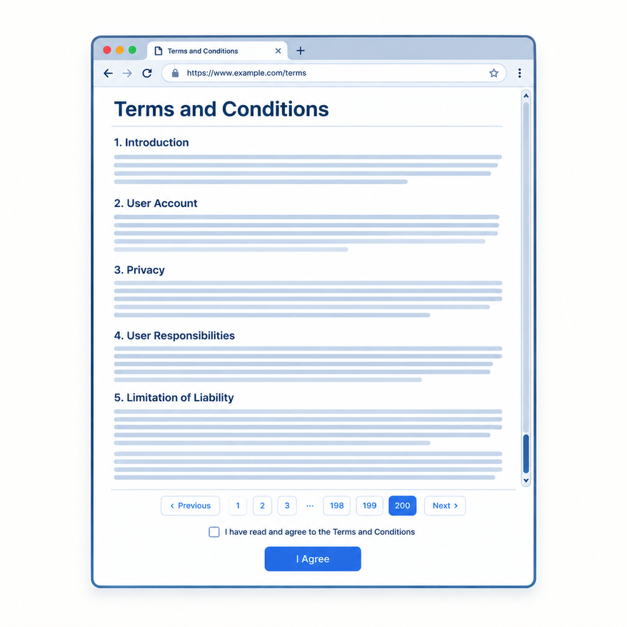
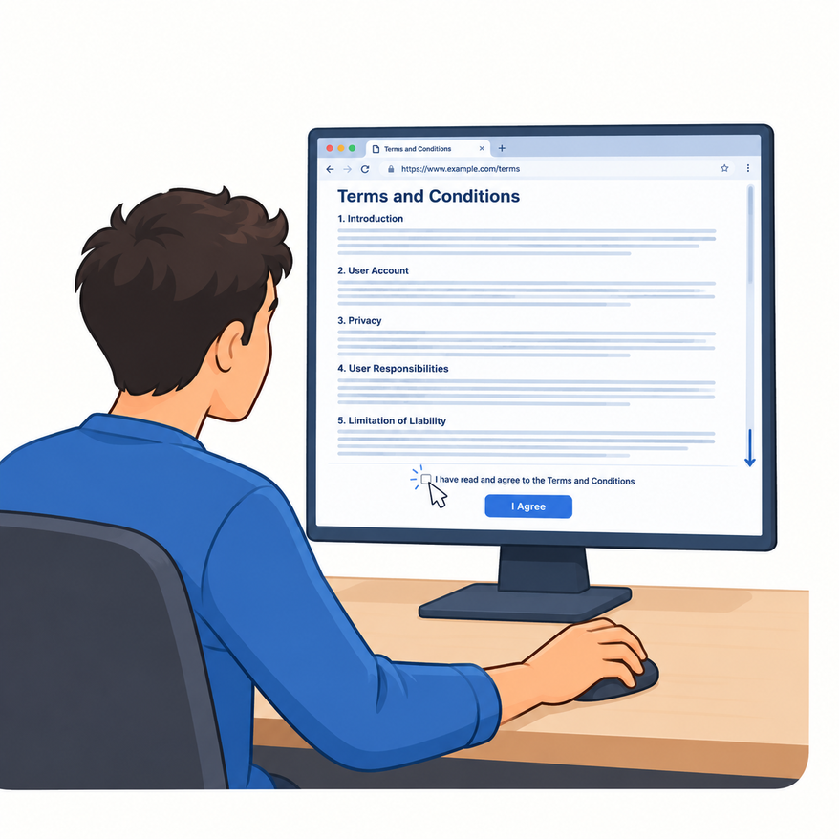
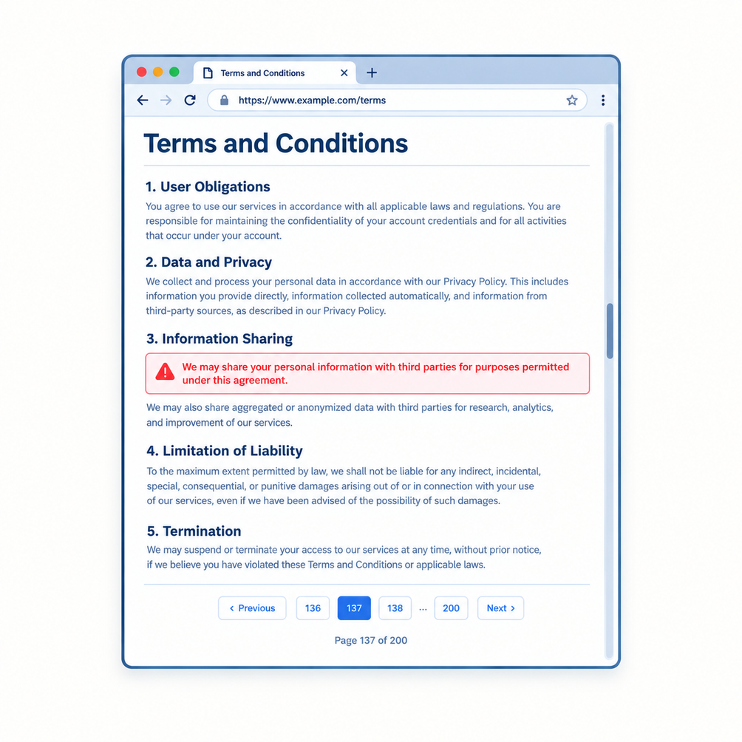
TERMS & CONDITIONS RISK FLAGGING USING ML
Long documents
Hard to review
Important clauses
Terms of Service and Privacy Policies are an unavoidable part of using online platforms. However, these documents can span hundreds of pages and contain complex legal language, making it difficult for users to understand the implications of individual clauses.

Slide 2
THE PROBLEM: IMPORTANT CLAUSES ARE EASY TO MISS
PROBLEM DEFINITION
WHY IS THIS INTERESTING?
Important clauses in lengthy Terms of Service and Privacy Policies can be difficult for users to identify and interpret.
REAL-WORLD RELEVANCE
1
Users encounter Terms of Service and Privacy Policies constantly.
LONG DOCUMENTS
Terms of Service can contain hundreds of pages and many different clauses.
2
ML CHALLENGE
§
COMPLEX LANGUAGE
Different clauses can have subtle differences in meaning, making classification non-trivial.
Legal wording can make subtle differences in meaning difficult to understand.
3
PRACTICAL VALUE
HARD TO REVIEW
ML can help identify individual clauses that deserve closer attention.
Users cannot realistically inspect every clause in detail.
THE KEY QUESTION
GOAL
Can machine learning help identify which clauses deserve closer attention?
Automatically classify individual clauses as Safe, Neutral, or Risky.

Slide 3
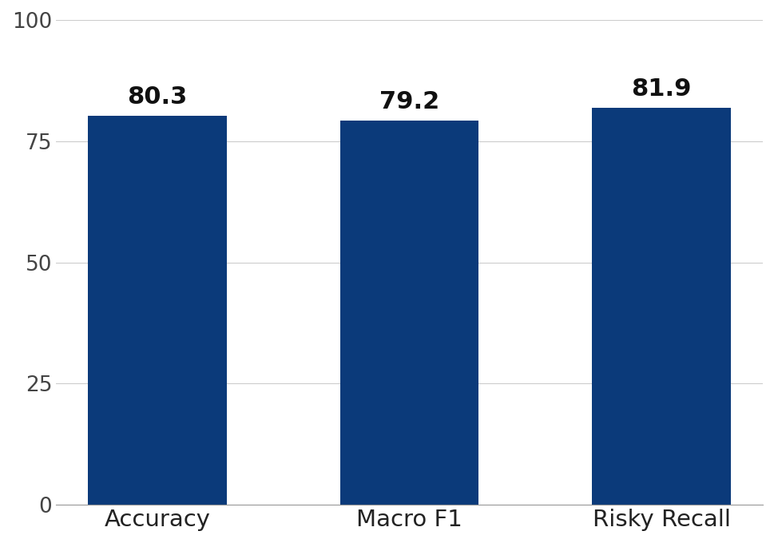
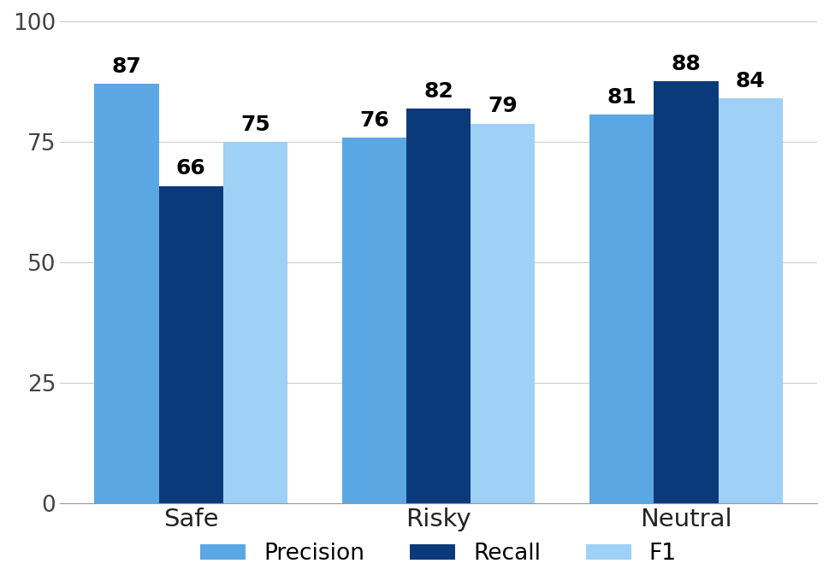
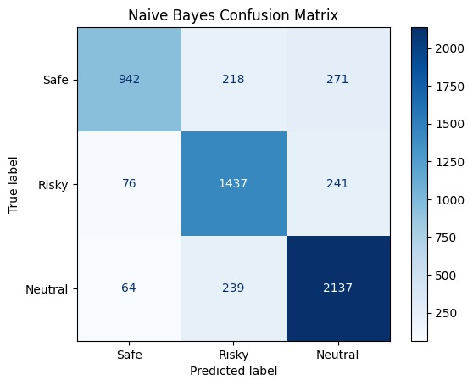
Multinomial Naive Bayes
Why Naive Bayes
Test set
Limitations
Fast, simple baseline for text
Separates Safe, Risky, Neutral
Probabilistic class scores
Input: clause text → TF-IDF features
Output: Safe / Neutral / Risky
Accuracy 80%, Macro F1 0.79 (5,625 clauses)
Assumes words contribute independently
Restrictive for legal language
Safe Recall is only 65.8%
Overall metrics (test set)
Per-class metrics
Confusion matrix
Baseline reference: the stronger models that follow are compared against these results.

Slide 4
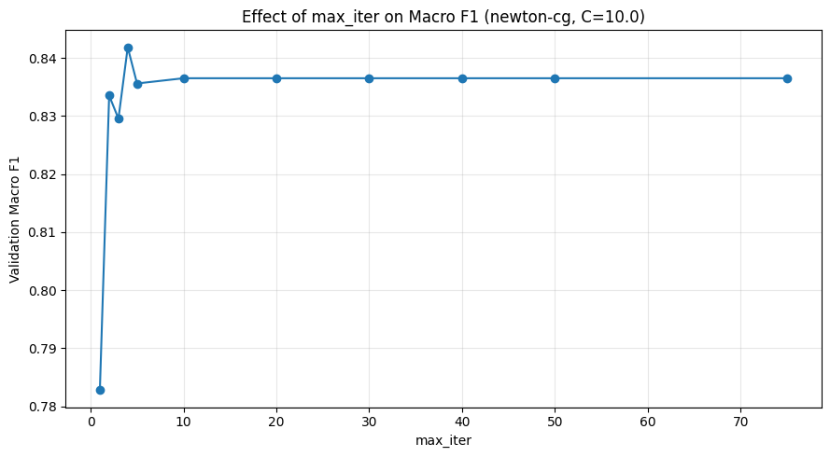
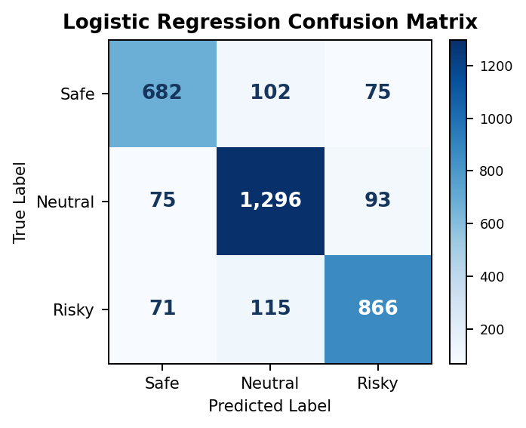
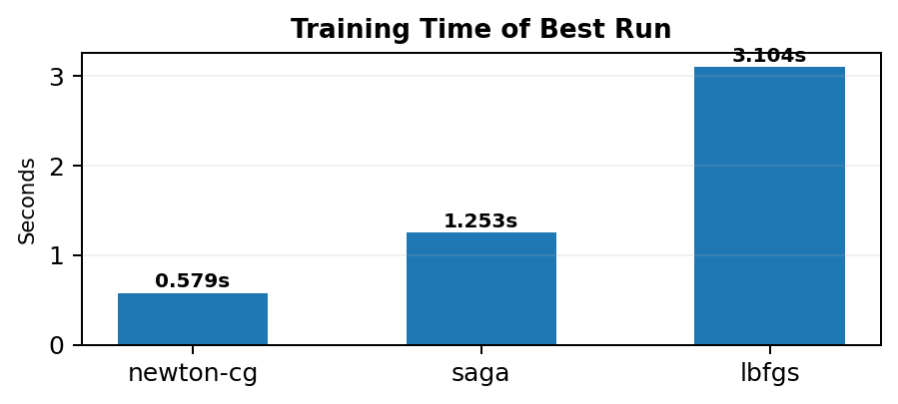
Logistic Regression: Our Model
Why Logistic Regression?
Setup and tuning
Takeaway
Well suited to sparse TF-IDF features
Supports multi-class classification
More expressive than Naive Bayes
TF-IDF: unigrams + bigrams
min_df = 2, max_df = 0.95
Tuned solver, C and max_iter
Improved on the Naive Bayes baseline (Accuracy 84.27%, Macro F1 83.65%), motivating SVM models.
HOW IT WORKS
Effect of max_iter on Macro F1
Confusion Matrix
Clause text
Raw ToS clause
↓
TF-IDF
Numerical features
↓
Logistic Regression
Class probabilities
↓
Risk class
Safe • Neutral • Risky
TF-IDF configuration
• n-grams = (1,2)
• min_df = 2
• max_df = 0.95
Selected by validation Macro F1: Newton-CG · C = 10 · max_iter = 1000

Slide 5
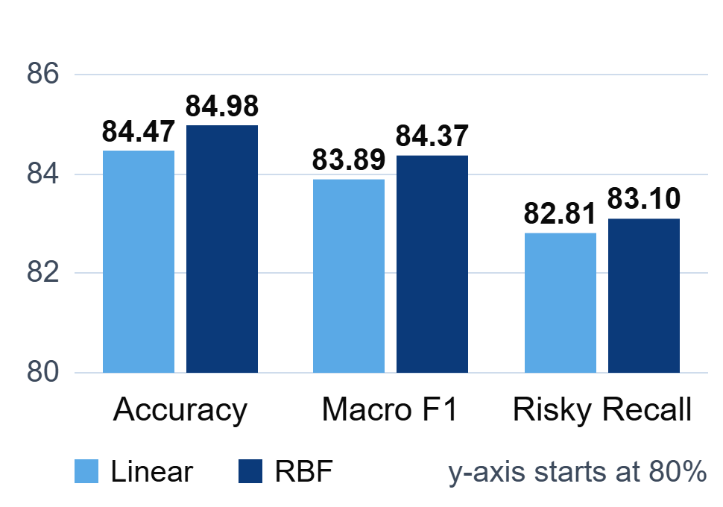
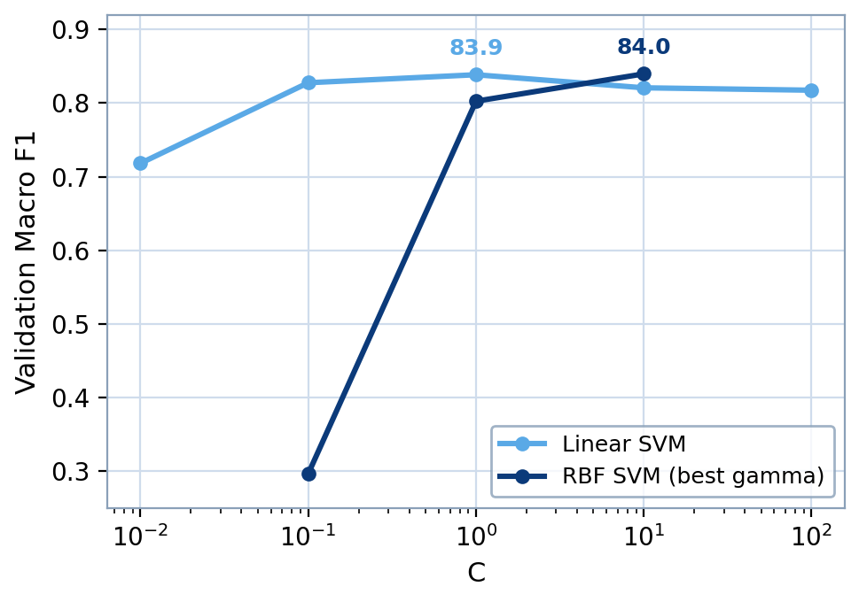
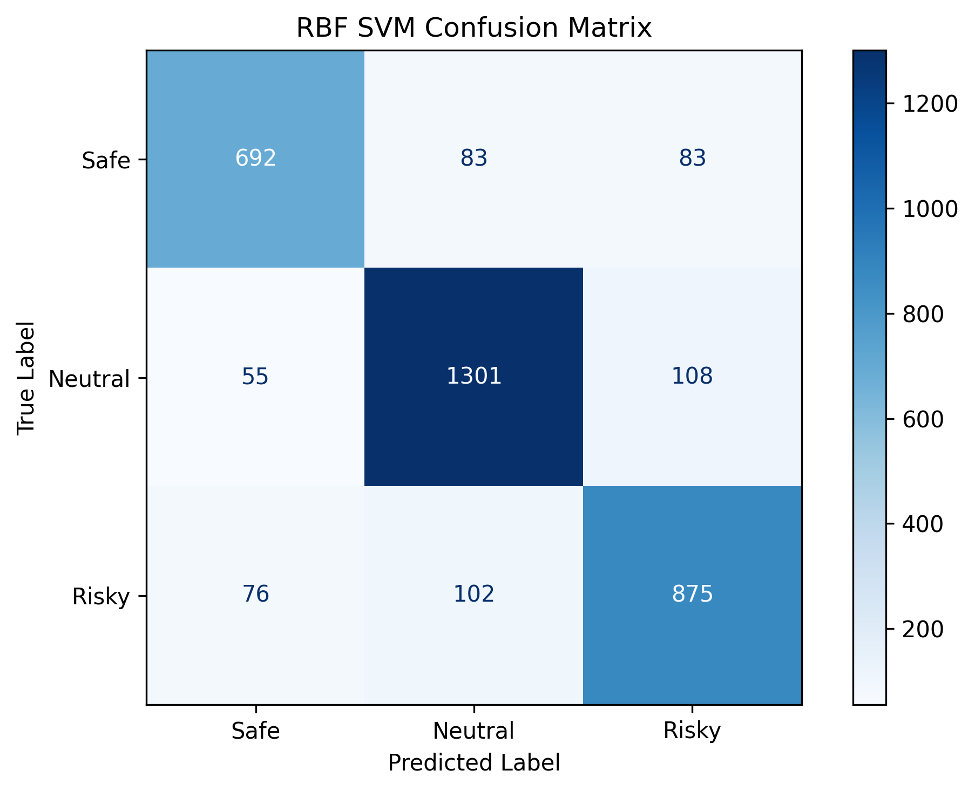
Support Vector Machine (SVM): Our Final Model
Why SVM
Setup and tuning
Takeaway
Effective for high-dimensional TF-IDF text
Strong class separation
Compared Linear and RBF kernels
TF-IDF, unigrams + bigrams
C tuned for both kernels
FINAL: RBF SVM, C = 10, γ = 0.1
RBF SVM achieved the best overall performance among the evaluated models. Risky Recall: 83.10%.
Linear vs RBF (test set)
Tuning: Macro F1 vs C
RBF confusion matrix
Clause-level classification: document-level summaries are aggregated from clause predictions, not predicted directly.

Slide 6
RESULTS, WORK DONE & REMAINING PLAN
RESULTS
84.98%
84.37%
83.10%
FINAL MODEL: RBF SVM
Best overall model among the evaluated approaches.
Accuracy
Macro F1
Risky Recall
WORK DONE TO DATE
DATA & PREPROCESSING
Inspected the ToS;DR dataset
Prepared clause-level training data
Filtered reliable approved annotations
Mapped labels to Safe / Neutral / Risky
Applied TF-IDF preprocessing
MODEL DEVELOPMENT
Evaluated Naive Bayes
Evaluated Logistic Regression
Compared Linear and RBF SVM
Tuned model hyperparameters
Selected RBF SVM
Model comparison
Model | Accuracy | Macro F1 | Risky Recall
Naive Bayes | 80.3% | 79.2% | 81.9%
Logistic Regression | 84.27% | 83.65% | 82.32%
Linear SVM | 84.47% | 83.89% | 82.81%
RBF SVM (final) | 84.98% | 84.37% | 83.10%
PLAN FOR THE REMAINING DAYS
01 VALIDATE
Test with additional real ToS documents
Analyze incorrect predictions
Check clause-segmentation edge cases
Implement document parsing and clause segmentation
02 REFINE & SYSTEM INTEGRATION
Improve result presentation
Improve risky-clause highlighting
Refine document-level summary
Integrate trained model into backend
03 FINALIZE & USER INTERFACE
Frontend upload -> Backend prediction
Perform final evaluation
Document limitations
Prepare final report and presentation

